Slide 1

Investigation of the development of the Robotic Dexterous Hands
A Deep Dive into Mechanics, Transmission, and Actuation
Lihao Zhou
Oct 2025
Department of Mechanical Engineering (IDT)

Slide 2
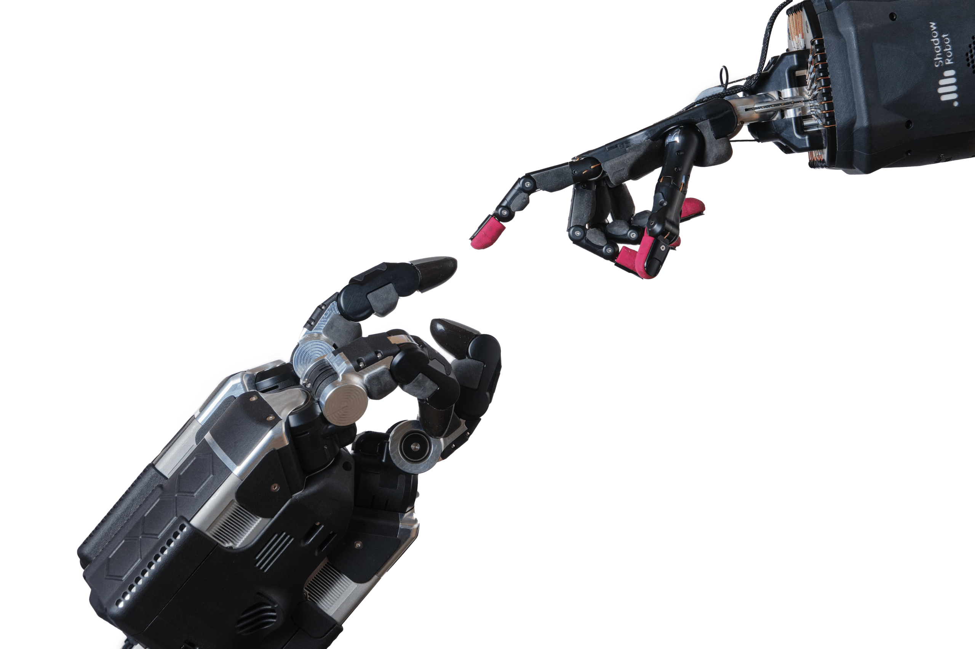
The intelligence of the dexterous hand is manifested in the synergy between its hardware and software.
Basic Mechanical design
Actuation and Transmission
Sensing Capacity
Materials and manufacturing
Control and High-Level AI
Notes:
灵巧手的智能体现在其软硬件的协同之中。本次汇报将提供一个特定的技术视角，聚焦于实现其灵巧性的物理基础——即机械结构、传动与驱动系统

Slide 3
The intelligence of the dexterous hand is manifested in the synergy between its hardware and software.
Basic Mechanical design
Actuation and Transmission
Sensing Capacity
Materials and manufacturing
Control and High-Level AI
Basic Mechanical design
Actuation and Transmission
Notes:
尽管灵巧手的发展面临感知、控制等多方面的挑战，深入理解其硬件基础对于评估整体性能至关重要。本分析将基于报告发现，深入探讨Mechanical, Transmission, and Motors 这三个相互关联的领域， 最后还会附带一点市场的数据作为进一步的佐证

Slide 4
Mechanical design: The Trade-off Between Adaptability, Coupling and Rigidity
The mechanical structure presets the hand's movement patterns and ability boundaries
Adaptability: Fully actuated - High precision, High cost, Control complexity
Underactuated - Passive adaptive, Simple Control, High Robustness
Coupling: Tendo-drive – High flexibility, High space utilization, Low durability
Linkage-driven – Mature, High rigidity, High precision, Direct drive
Rigidity Balance: High rigidity (high precision, large load) vs. low rigidity/softness (safe interaction)
Notes:
适应性与耦合与刚性之间的权衡
适应性是指灵巧手通过例如欠驱动等机械设计，无需复杂主动控制就能被动贴合不同形状物体的固有能力
Fully Actuated 全驱动: 高精度 | 控制复杂 | 高成本
Underactuated 欠驱动: 被动自适应 | 控制简单 | 高鲁棒性

Slide 5
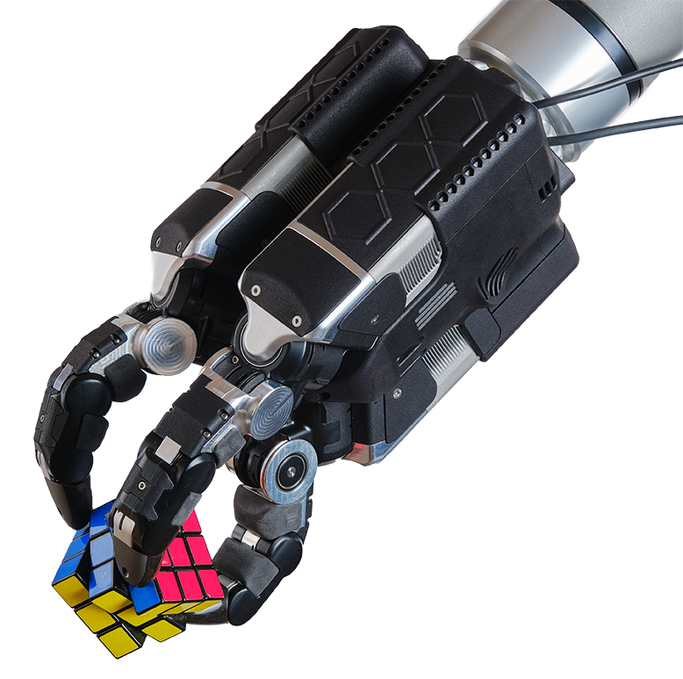
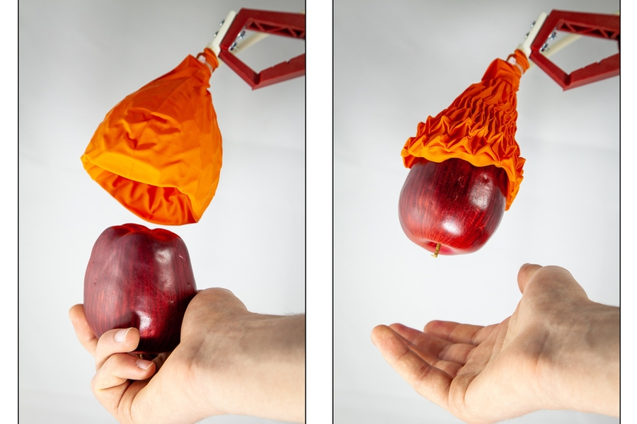
Mechanical design: The Trade-off Between Adaptability, Coupling and Rigidity
The mechanical structure presets the hand's movement patterns and ability boundaries
Adaptability: Fully actuated - High precision, High cost, Control complexity
Underactuated - Passive adaptive, Simple Control, High Robustness
Coupling: Tendo-drive – High flexibility, High space utilization, Low durability
Linkage-driven – Mature, High rigidity, High precision, Direct drive
Rigidity Balance: High rigidity (high precision, large load) vs. low rigidity/softness (safe interaction)
Notes:
无需复杂主动控制就能被动贴合不同形状物体的固有能力

Slide 6
Mechanical design: The Trade-off Between Adaptability, Coupling and Rigidity
The mechanical structure presets the hand's movement patterns and ability boundaries
Adaptability: Fully actuated - High precision, High cost, Control complexity
Underactuated - Passive adaptive, Simple Control, High Robustness
Coupling: Tendo-drive – High flexibility, High space utilization, Low durability
Linkage-driven – Mature, High rigidity, High precision, Direct drive
Rigidity Balance: High rigidity (high precision, large load) vs. low rigidity/softness (safe interaction)
Notes:
耦合是什么 & 优势： 关节通过机械结构（如连杆）关联运动，实现预编程的稳定抓取姿态，控制简单
Tendon-driven 肌腱驱动: 高灵活性 | 空间利用率高
Linkage-driven 联动驱动: 高刚性 | 高精度 | 直接传动

Slide 7
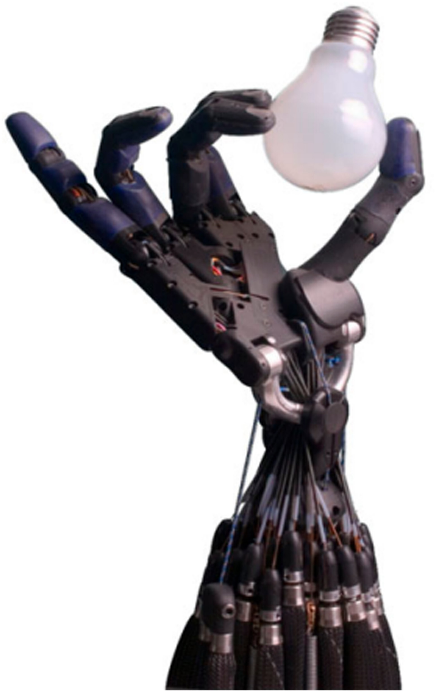
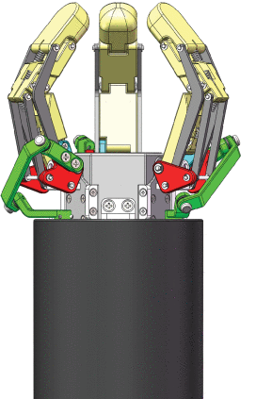
Mechanical design: The Trade-off Between Adaptability, Coupling and Rigidity
The mechanical structure presets the hand's movement patterns and ability boundaries
Adaptability: Fully actuated - High precision, High cost, Control complexity
Underactuated - Passive adaptive, Simple Control, High Robustness
Coupling: Tendo-drive – High flexibility, High space utilization, Low durability
Linkage-driven – Mature, High rigidity, High precision, Direct drive
Rigidity Balance: High rigidity (high precision, large load) vs. low rigidity/softness (safe interaction)

Slide 8
Mechanical design: The Trade-off Between Adaptability, Coupling and Rigidity
The mechanical structure presets the hand's movement patterns and ability boundaries
Adaptability: Fully actuated - High precision, High cost, Control complexity
Underactuated - Passive adaptive, Simple Control, High Robustness
Coupling: Tendo-drive – High flexibility, High space utilization, Low durability
Linkage-driven – Mature, High rigidity, High precision, Direct drive
Rigidity Balance: High rigidity (high precision, large load) vs. low rigidity/softness (safe interaction)
Notes:
刚性权衡： 高刚性（精度高、负载大）vs 低刚性/柔顺性（交互安全、被动适应）

Slide 9
Transmission system - transmitter of power and motion
Transmission is the bridge that converts motor movement into joint action
Tendo – drive
Advantages: High flexibility, High space utilization
Disadvantages: Lower lifespan and Reliability
Representative: Tesla Optimus Hand
Linkage/Gear drive
Advantages: High load capacity, High precision, Mature and commonly used
Disadvantages: Not suitable for High-speed movement
Representative: Inspire Robots (因时机器人)
Notes:
核心思想： 传动是将电机运动转化为关节动作的桥梁
1. 腱绳传动
优势： 高空间利用率、高灵活性。劣势： 较低寿命和可靠性
代表案例： Tesla Optimus Hand
2. 连杆/齿轮传动
优势： 高负载能力、高精度、成熟常用。劣势： 不适合高速运动
代表案例： Inspire Robots 灵巧手

Slide 10
Drive Motor – The “muscles” of the dexterous hand
The motor is the source of power, determining performance and size
Rotary motor + Reducer: Most Common scheme, through gears to reduce speed and increase torque
Linear screw servo: High efficiency, high integration
Representative: The core miniature linear servo actuators of Inspire Robots (因时机器人)
Worm gear motor: Compact structure, high reduction ratio, self-locking
Representative: Tesla Optimus 1st generation hand transmission solution
Notes:
核心思想： 电机是动力的源头，决定了性能与尺寸
1. 旋转电机 + 减速器
最常见方案，通过齿轮减速增矩
2. 线性丝杠舵机
优势： 高效率、高集成度
代表案例： Inspire Robots 的核心微型直线伺服舵机
3. 蜗轮蜗杆电机
优势： 结构紧凑、大减速比、自锁
代表案例： Tesla Optimus 第一代手传动方案
Why Tesla only used in 1st generation??

Slide 11
Marketing
In 2024, the global multi-finger dexterous robot market is valued at approximately $2.02 billion. The expected compound annual growth rate (CAGR) is projected to be above 26% to 39.2%, with the market size reaching around $15.26 billion by 2030
The Chinese humanoid robot industry is expected to expand from approximately 5.3 billion yuan in 2025 to 38.7 billion yuan in 2028
Notes:
这一切技术的背后，是一个快速增长的市场。全球灵巧手市场预计在2030年达到约150亿美元，中国的人形机器人市场同样爆发在即，这为硬件技术的创新提供了强劲动力

Slide 12
Summary: The Mechanical Foundation Defines the Path
The synergy of Mechanics, Transmission, and Actuation forms the indispensable physical basis for dexterous hand intelligence
Mechanical
- Adaptability
- Coupling
- Rigidity
Transmission
- Tendo-Drive
- Linkage-Driven
Actuation
- Rotary Motors
- Linear Servos
- Worm Gear
Market validation
Driven by the booming humanoid robot market (CAGR > 26%), optimizing this hardware stack has never been more critical
Future Challenges
The key challenge lies in balancing performance, cost, and reliability, which highlights the need for continuous innovation in modularization and robust design
Notes:
总结来说，机械、传动、驱动三者的协同是灵巧手智能的物理基石。在火热的市场驱动下，优化这一硬件体系至关重要，而未来的核心挑战在于如何平衡性能、成本与可靠性

Slide 13
Reference
https://news.mit.edu/2019/new-robot-hand-gripper-soft-and-strong-0315
https://shadowrobot.com/news/press-releases/shadow-robot-unveils-the-worlds-most-robust-dexterous-robot hand-developed-in-partnership-with-google-deepmind/
S. Kadalagere Sampath, N. Wang, H. Wu, and C. Yang, ‘Review on human‐like robot manipulation using dexterous hands’, Cognitive Comp and Systems, vol. 5, no. 1, pp. 14–29, Mar. 2023, doi: 10.1049/ccs2.12073.
G. Li, X. Liang, Y. Gao, T. Su, Z. Liu and Z. -G. Hou, "A Linkage-Driven Underactuated Robotic Hand for Adaptive Grasping and In-Hand Manipulation," in IEEE Transactions on Automation Science and Engineering, vol. 21, no. 3, pp. 3039-3051, July 2024, doi: 10.1109/TASE.2023.3273721.
‘Humanoid Robot Market Size, Share & Trends, 2025 To 2030’, Marketsandmarkets. Accessed: Oct. 05, 2025. [Online]. Available: https://www.marketsandmarkets.com/Market-Reports/humanoid-robot-market-99567653.html?gad_source=1&gad_campaignid=261349036&gbraid=0AAAAADxY7Syoa-FKvOMRBEJAN-RoVuxz4&gclid=CjwKCAjwi4PHBhA-EiwAnjTHuaqBkRrPGJP8ynA3EKdZyq DLv6aPtpJsuYyNHl3oDGTByZINkogVBoC7I4QAvD_BwE
B. Wu, ‘The Next Trillion-Dollar Industry: Humanoid Robots’, naipnews. Accessed: Oct. 05, 2025. [Online]. Available: https://naipnews.naipo.com/zh-hans/27791/

